Slide 1
Clue Letter

Slide 2
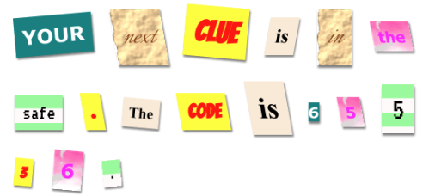
Clue Letter

Slide 3
Think of a clue to solve a mystery or message to say
You can use quotes if you like
https://wealthygorilla.com/33-inspirational-quotes-for-kids/
http://www.momjunction.com/articles/simple-thought-of-the-day-quotes-for-kids_00438812/

Slide 4
Create the clue letter
Set up a folder system
clue folder
images folder
css folder

Slide 5
Create the clue letter
In the clue folder
Create a new file Name it clue.html

Slide 6
Create the clue letter
Open clue.html
Create a basic HTML file
<html>
<head>
<link rel=”stylesheet” href=”/clue/css/style.css”>
</head>
<body>
</body>
</html>

Slide 7
Create the clue letter
<p>
<span class="">Replace</span>
<span class="">these</span>
<span class="">words</span>
<span class="">with</span>
<span class="">your</span>
<span class="">own</span>
<span class="">mystery</span>
<span class="">message</span>
<span class="">.</span>
<span class="">Make</span>
<span class="">it</span>
<span class="">about</span>
<span class="">12</span>
<span class="">words</span>
<span class="">long</span>
<span class="">.</span>
</p>
Use this template to set up the text for the letter
You can copy and paste
<html>
<head>
<link rel=”stylesheet” href=”/clue/css/style.css”>
</head>
<body>
</body>
</html>

Slide 8
The <span> allows you color or modify one section of words
<span>

Slide 9
Change the words to say what you wish

Slide 10
View the HTML file

Slide 11
Something is missing

Slide 12
Something is missing
Go to the css folder in the clue folder
Download the style.css and prefixfree.js from the class resources to your downloads folder
bit.ly/tci52018
Upload the style.css and prefixfree.js to the /clue/css folder
by dragging the file from the downloads folder to the css folder on the internet

Slide 13
Something is missing
Go to the images folder in the clue folder
Download
canvas.png
computer-printout-paper.png
pink-pattern.png
rough-paper.png
from the class resources to your downloads folder
bit.ly/tci52018

Slide 14
Something is missing
Upload the images to the /clue/images folder
by dragging the file from the downloads folder to the images folder on the internet

Slide 15
Create the clue letter
Add a link to the prefixfree.js file
<html>
<head>
<link rel=”stylesheet” href=”/clue/css/style.css”>
<script src="/clue/css/prefixfree.js"></script>
</head>
<body>
<p>
….
</p>
</body>
</html>

Slide 16
View the HTML file

Slide 17
The prefixfree.js file uses Javascript!

Slide 18
The <script> code is needed to include javascript

Slide 19
Create the clue letter
Open the clue.html file
Notice the <span class=””> section?
Type magazine1 inside the “” section of a few of the lines
Type big inside the “” section of a few lines

Slide 20
View the HTML file

Slide 21
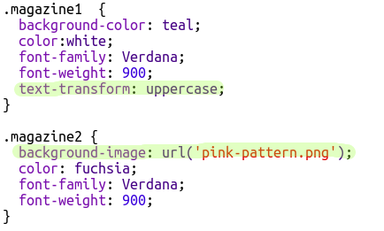
Notice the properties in the style.css file

Slide 22
You can change the background-image to canvas.png to see how it works

Slide 23
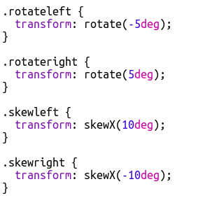
You can change the numbers for these properties to see how they work
Add some of these to the <span> tag to see it in action
(don’t type the . when you add these classes)

Slide 24
The . words in the CSS file are called Classes.
They are custom made styling for individual sections of <span> sections
Classes

Slide 25
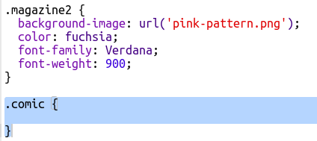
Make a Class
Add this class to your style.css style

Slide 26
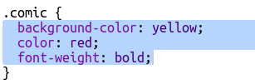
Make a Class
Finish making the class

Slide 27
Type comic in the <span class=””> for some lines

Slide 28
View the HTML file

Slide 29
You can add custom font to CSS styles

Slide 30
fonts.google.com/
Preview web fonts

Slide 31

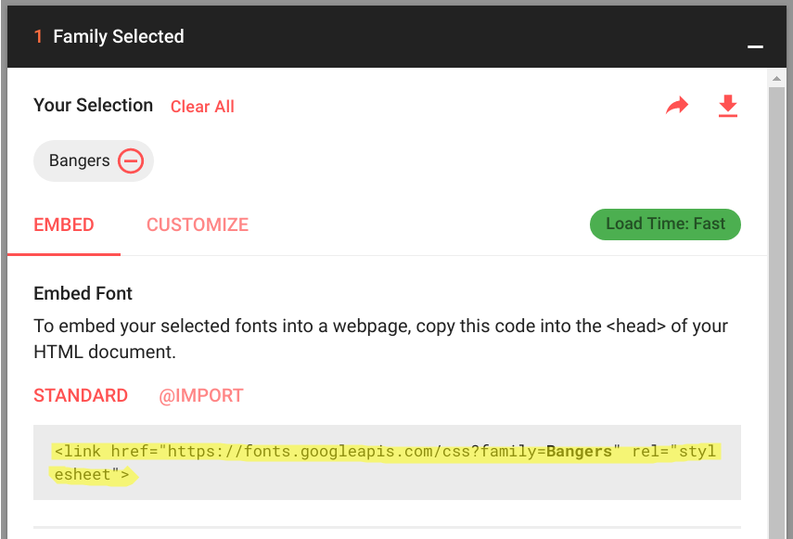
Add custom fonts
Click the + symbol to select the font
Click the _ at the bottom of the screen
Copy the Standard code at the first box
Paste the code into the <head> section
of the clue.html

Slide 32
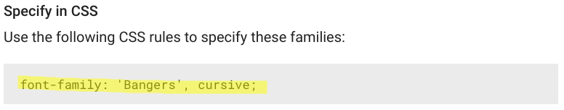
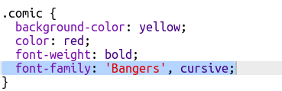
Add custom fonts
Paste the Specify in CSS code into the class of your css file

Slide 33
What message will you send?

